Slide 1
Accessibility Testing with WCAG 2.2
James Edwards
ARC Consultant

Slide 2
Level A Checkpoints in WCAG 2.2
3.2.6 Consistent Help
3.3.7 Redundant Entry

Slide 3
Level AA Checkpoints in WCAG 2.2
2.4.11 Focus Not Obscured (Minimum)
2.5.7 Dragging Movements
2.5.8 Target Size (Minimum)
3.3.8 Accessible Authentication (Minimum)

Slide 4
Level AAA Checkpoints in WCAG 2.2
2.4.12 Focus Not Obscured (Enhanced)
2.4.13 Focus Appearance
3.3.9 Accessible Authentication (Enhanced)

Slide 5
3.2.6 Consistent Help (Level A)

Slide 6
Normative requirements for 3.2.6
If a Web page contains any of the following help mechanisms, and those mechanisms are repeated on multiple Web pages within a set of Web pages, they occur in the same order relative to other page content, unless a change is initiated by the user:
Human contact details
Human contact mechanism
Self-help option
A fully automated contact mechanism

Slide 7
Examples of content relevant to 3.2.6

Slide 8
Manual testing for 3.2.6
Identify the presence of a repeated help mechanism.
Verify that it appears in the same relative order on each page.
Repeat for each responsive breakpoint.

Slide 9
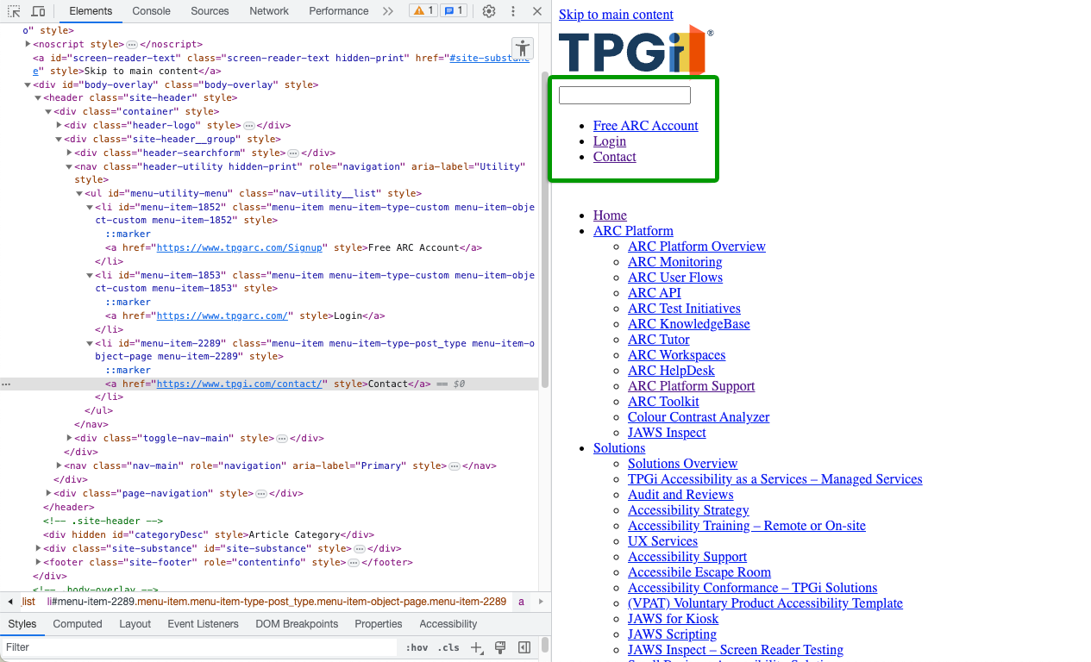
Illustration of a page setup for testing 3.2.6

Slide 10
Testing barriers for 3.2.6
No obvious barriers.

Slide 11
Automated testing for 3.2.6
CANNOT BE TESTED BY AUTOMATION.
Automation doesn’t hold memory between pages.
Same content may not be identifiable.
Help mechanism may not be identifiable anyway.
LLM analysis might make this possible in future.

Slide 12
3.3.7 Redundant Entry (Level A)

Slide 13
Normative requirements for 3.3.7
Information previously entered by or provided to the user that is required to be entered again in the same process is either:
auto-populated, or
available for the user to select
Except when:
re-entering the information is essential,
the information is required to ensure the security of the content, or
previously entered information is no longer valid

Slide 14
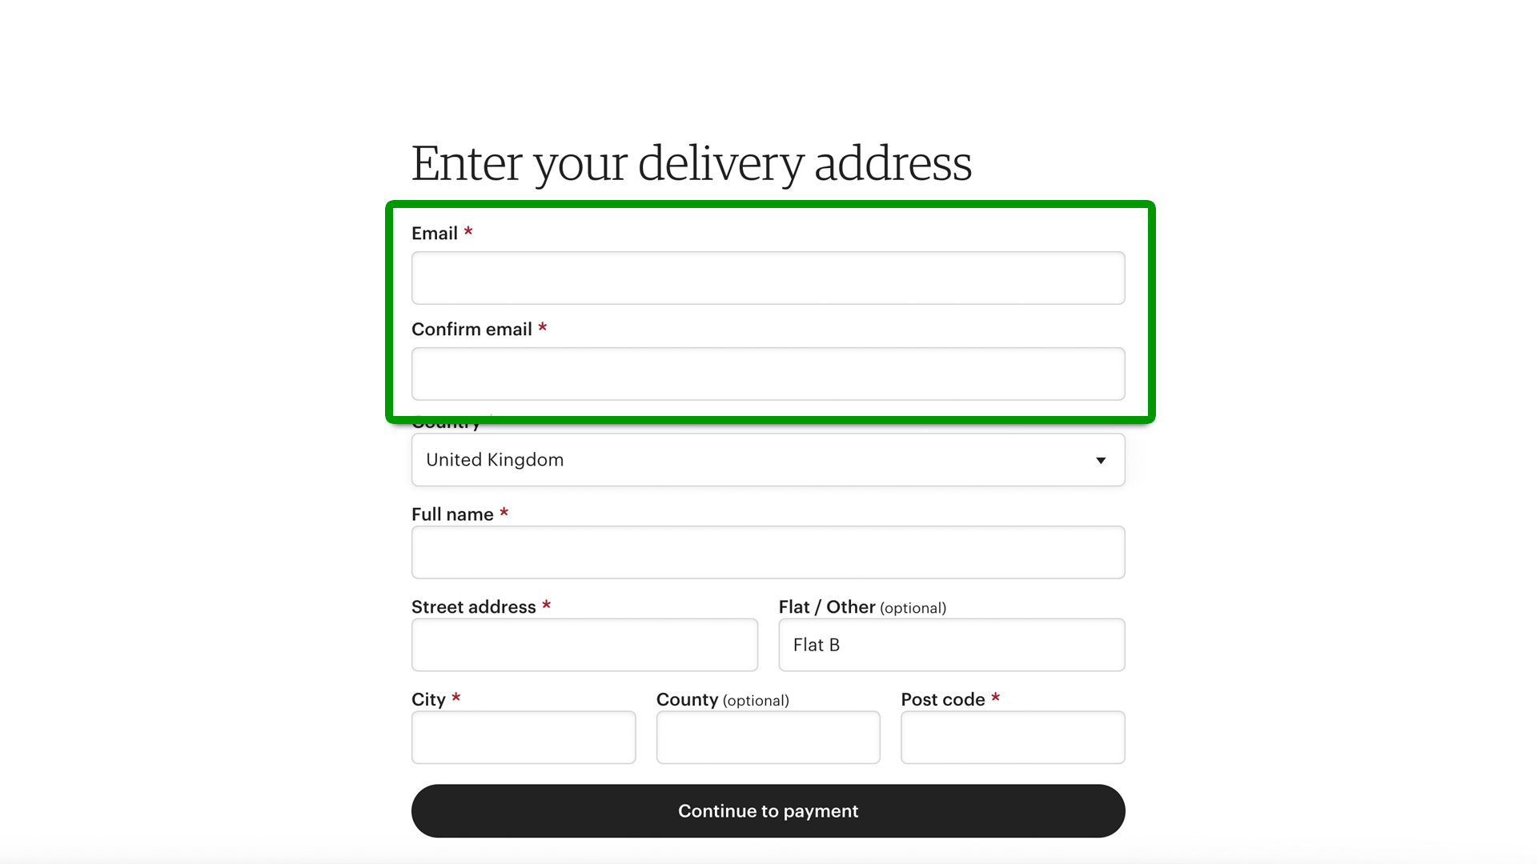
Examples of content relevant to 3.3.7

Slide 15
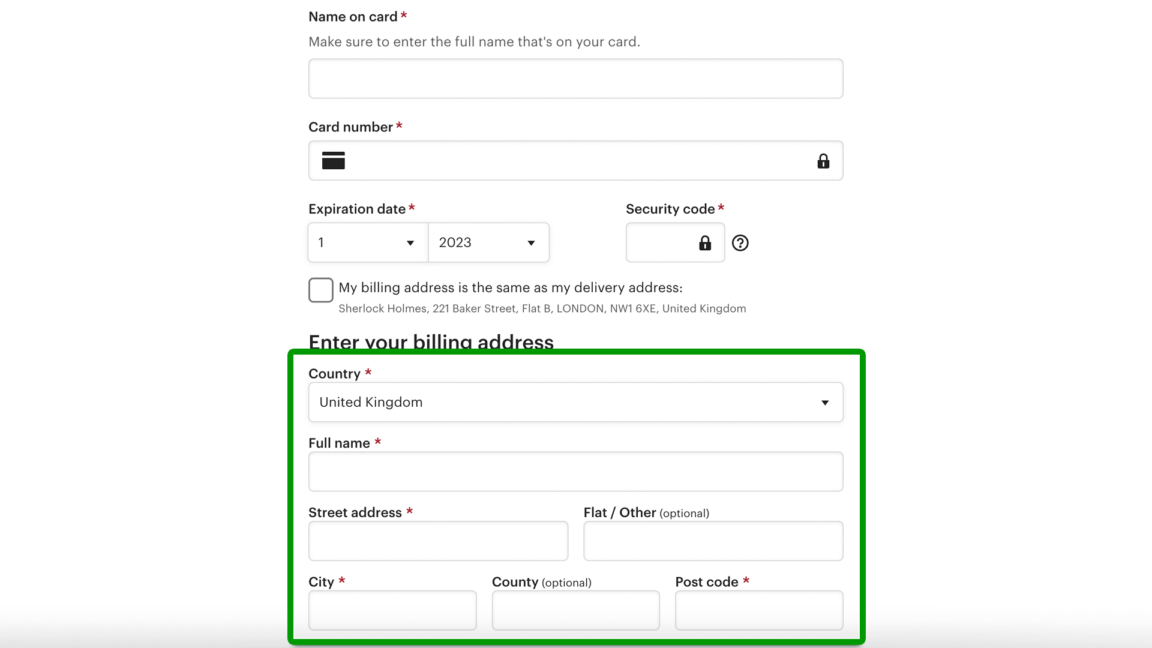
More examples of content relevant to 3.3.7

Slide 16
Manual testing for 3.3.7
Identify applicable form fields.
Ignore those where exceptions apply.
Verify that redundant information is (either):
Auto-populated
Available for the user to select

Slide 17
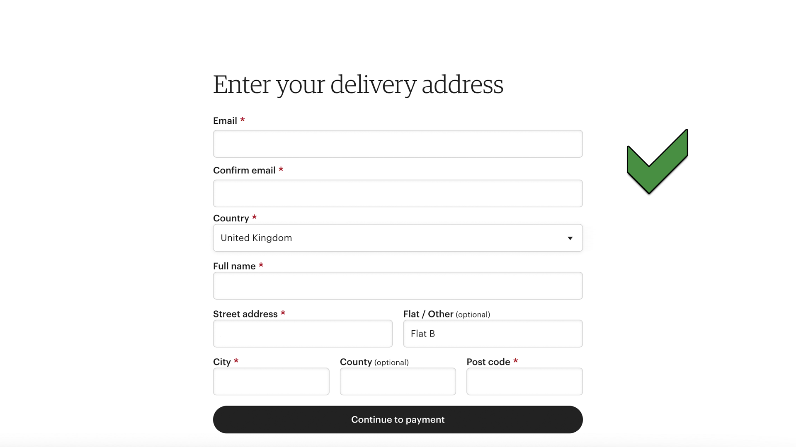
Examples of content that passes 3.3.7

Slide 18
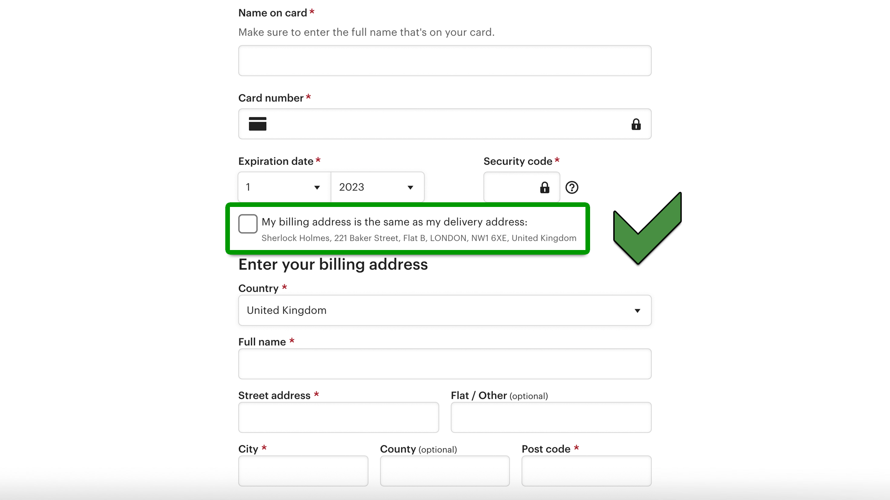
More examples of content that passes 3.3.7

Slide 19
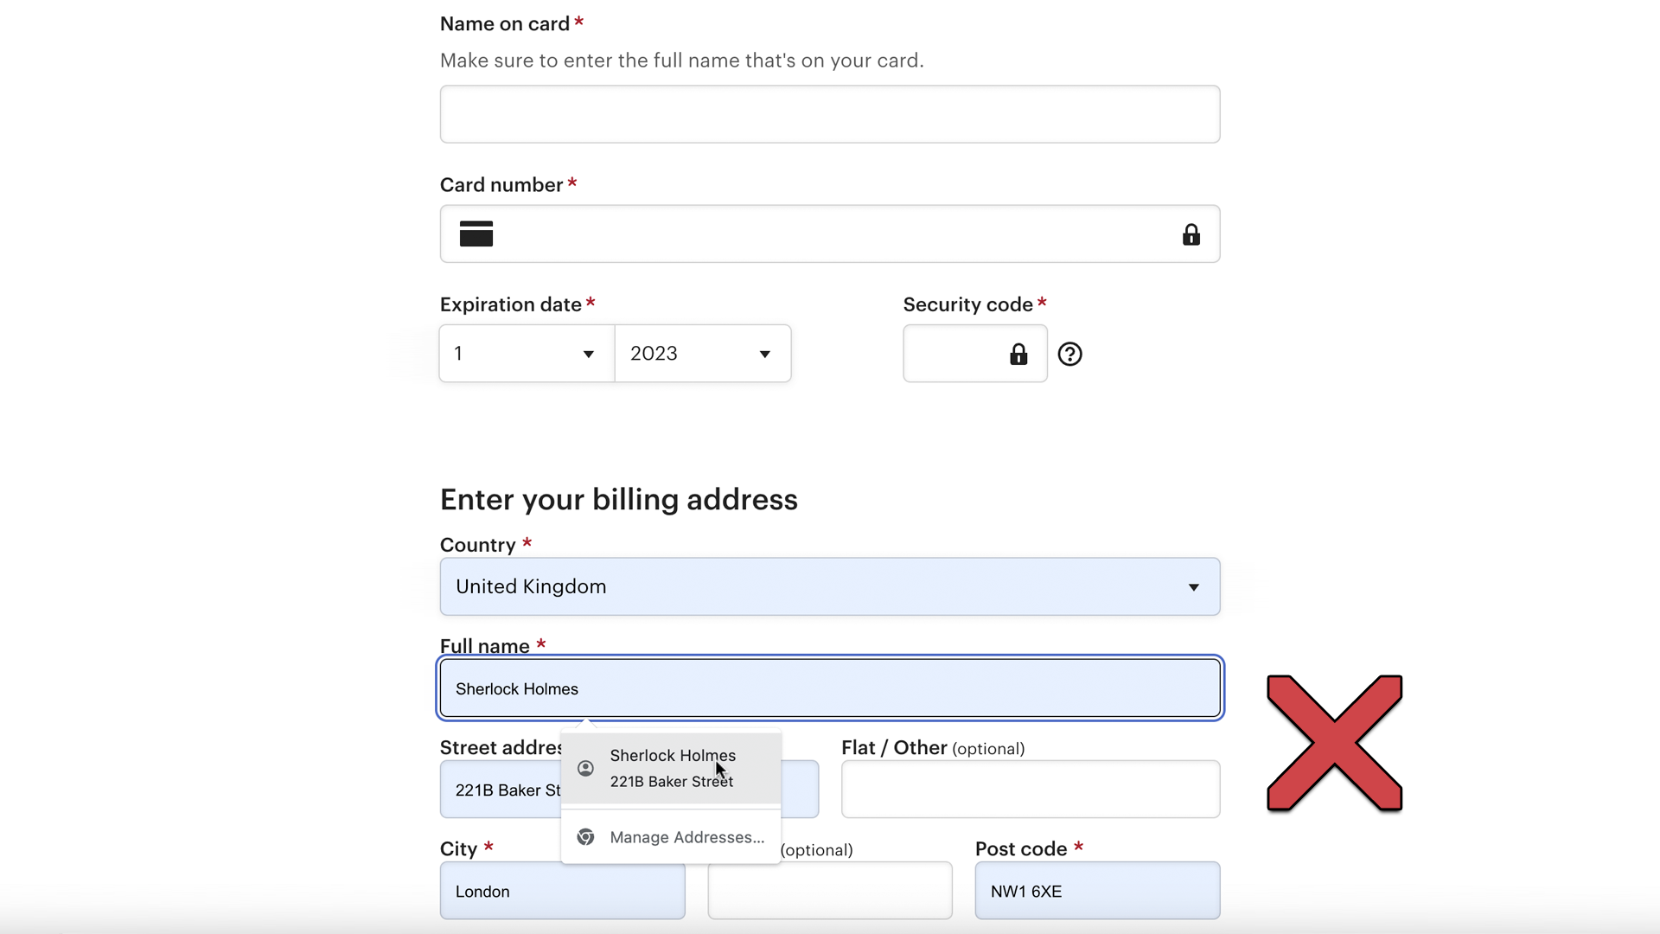
Examples of content that fails 3.3.7

Slide 20
Testing barriers for 3.3.7
No obvious barriers.

Slide 21
Automated testing for 3.3.7
CANNOT BE TESTED BY AUTOMATION.
Automation doesn’t hold memory between pages.
Same content may not be identifiable.
Some exceptions are judgment calls.
LLM analysis might make this possible in future.

Slide 22
2.4.11 Focus Not Obscured (Minimum) (Level AA)

Slide 23
Normative requirements for 2.4.11
When a user interface component receives keyboard focus, the component is not entirely hidden due to author-created content.

Slide 24
Manual testing for 2.4.11
Identify the presence of focusable elements.
Manually SHIFT/TAB through all such elements (both ways).
Check for interactive exceptions.
Verify that none are entirely obscured on focus.
Repeat for each responsive breakpoint.

Slide 25
Testing barriers for 2.4.11
Requires the ability to make visual and spatial comparisons. (But all of this can be automated anyway…)

Slide 26
Automated testing for 2.4.11
CAN BE TESTED BY AUTOMATION
Programmatically focus each focusable element.
Evaluate coordinates with all other visible elements.
Test on page load (no movable content).
Don’t action elements (no dismissible content).

Slide 27
2.4.12 Focus Not Obscured (Enhanced) (Level AAA)

Slide 28
Normative requirements for 2.4.12
When a user interface component receives keyboard focus, no part of the component is hidden by author-created content.

Slide 29
Manual testing for 2.4.12
Identify the presence of focusable elements.
Manually SHIFT/TAB through all such elements (both ways).
Check for interactive exceptions.
Verify that none are partially or entirely obscured on focus.
Repeat for each responsive breakpoint.

Slide 30
2.5.7 Dragging Movements (Level AA)

Slide 31
Normative requirements for 2.5.7
All functionality that uses a dragging movement for operation can be achieved by a single pointer without dragging, unless dragging is essential or the functionality is determined by the user agent and not modified by the author.

Slide 32
Manual testing for 2.5.7
Identify content that uses pointer dragging.
Ignore those where exceptions apply.
Verify that content can be used with single pointer actions.

Slide 33
Testing barriers for 2.5.7
Requires the ability to use pointer dragging movements.

Slide 34
Automated testing for 2.5.7
CANNOT BE TESTED BY AUTOMATION.
Complex manual interaction is required.
Relevant content may not be identifiable.
LLM analysis might make content identification possible in future.

Slide 35
2.5.8 Target Size (Minimum) (Level AA)

Slide 36
Normative requirements for 2.5.8 (abridged)
The size of the target for pointer inputs is at least 24 by 24 CSS pixels, except where:
Spacing: [smaller targets have sufficient spacing]
Equivalent: [the function can be achieved through a different control]
Inline: [the target is constrained by the line-height of non-target text]
User agent control: [the size is not author-modified]
Essential: [the presentation is essential or legally required]

Slide 37
Definition of “target” for 2.5.8
target
region of the display that will accept a pointer action, such as the interactive area of a user interface component.

Slide 38
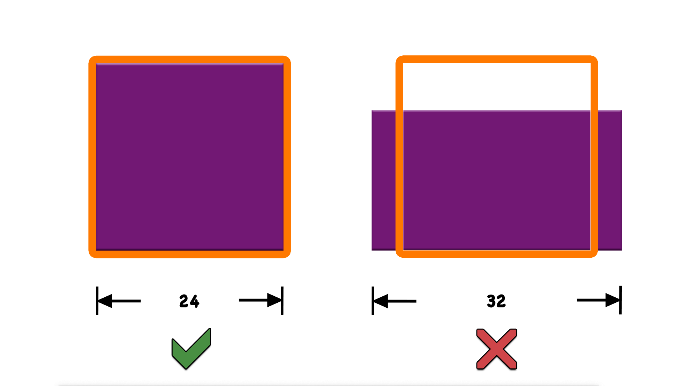
How aspect ratio makes a different to target size

Slide 39
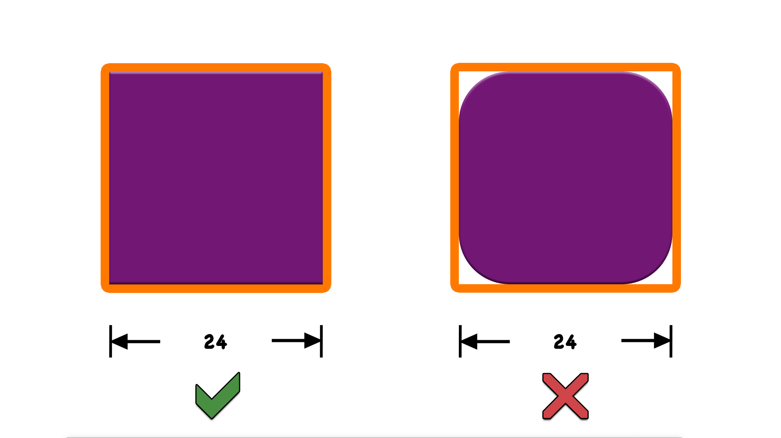
How rounded corners make a different to target size

Slide 40
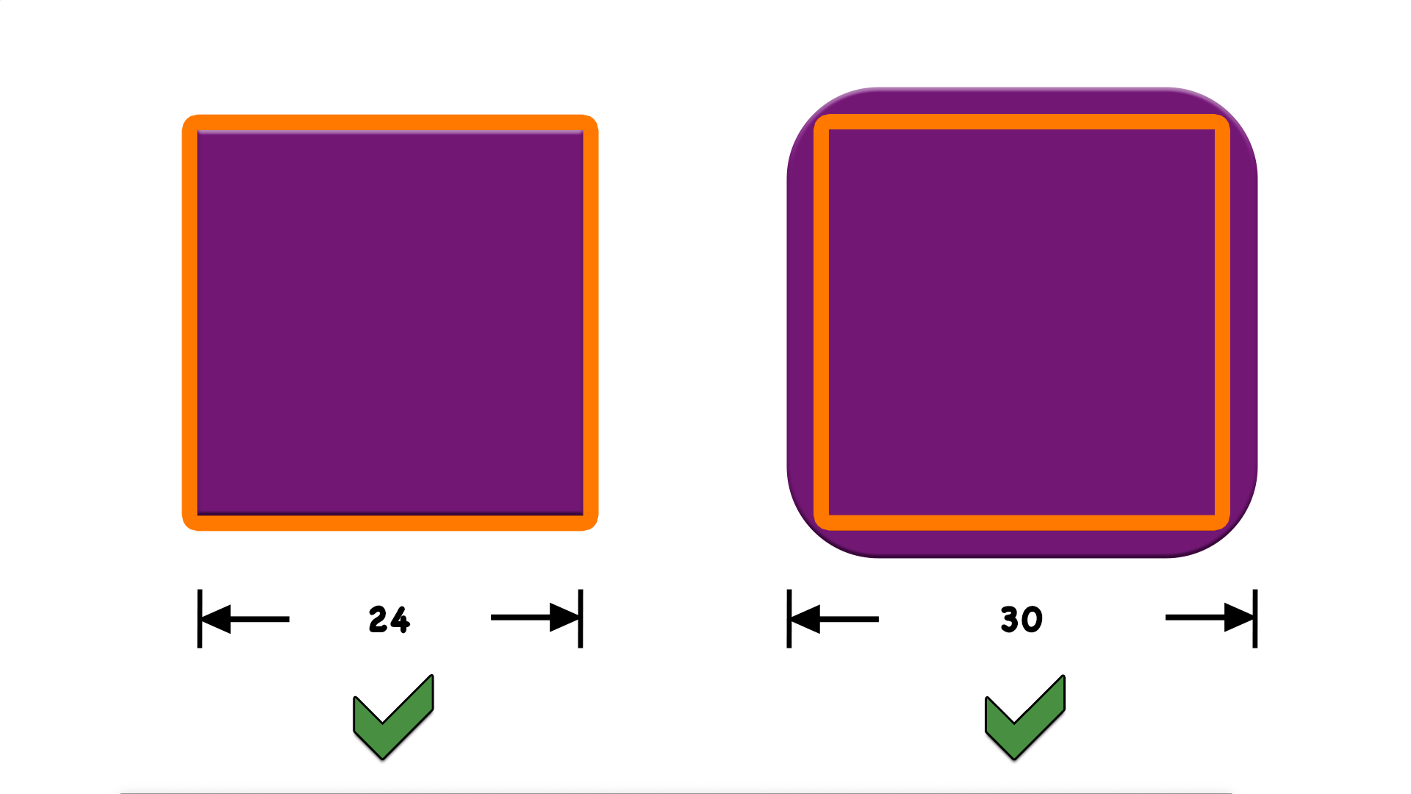
How an element’s size should be increased to account for rounded corners

Slide 41
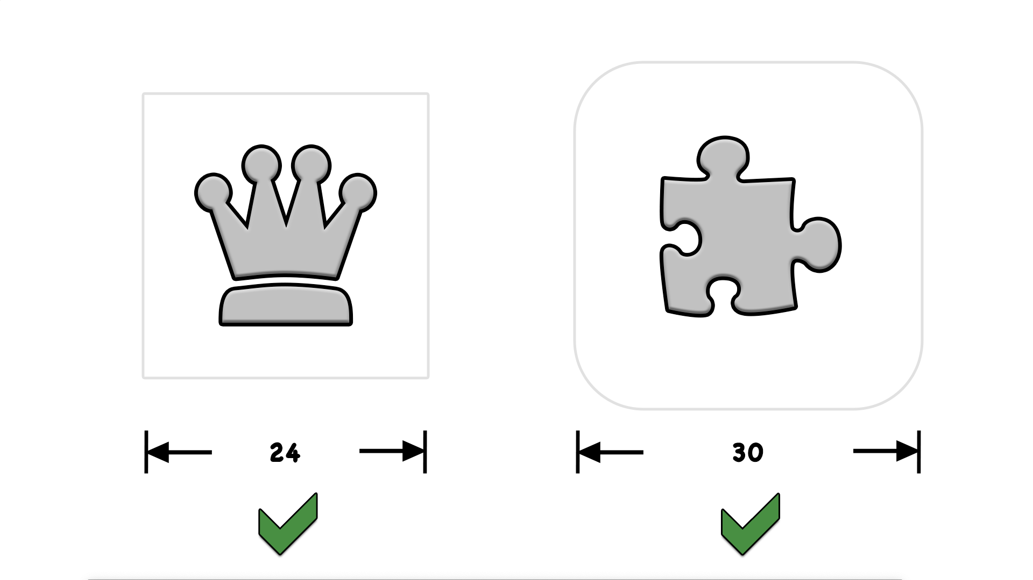
How the visible target can be smaller than the pointer target size

Slide 42
Manual testing for 2.5.8
Identify the presence of pointer targets.
Ignore those where exceptions apply.
Verify that targets have sufficient size or spacing.

Slide 43
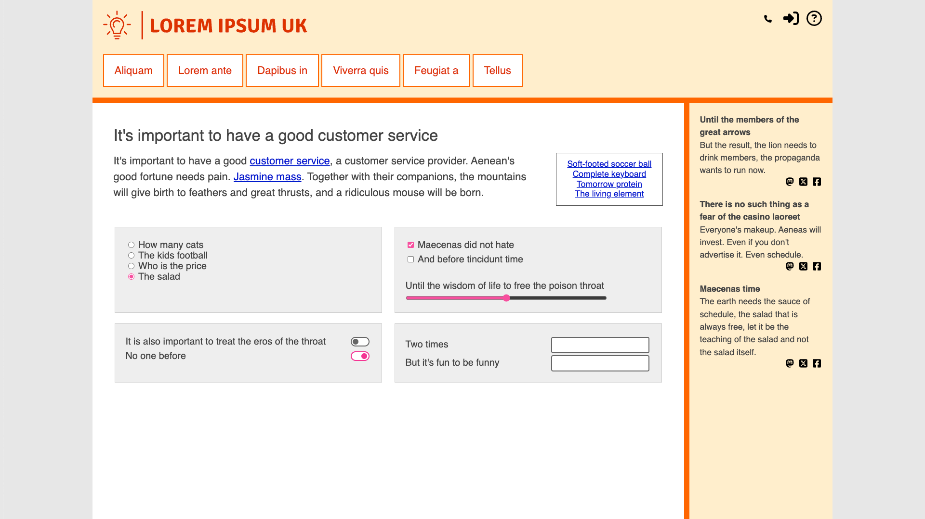
Examples of content relevant to 2.5.8

Slide 44
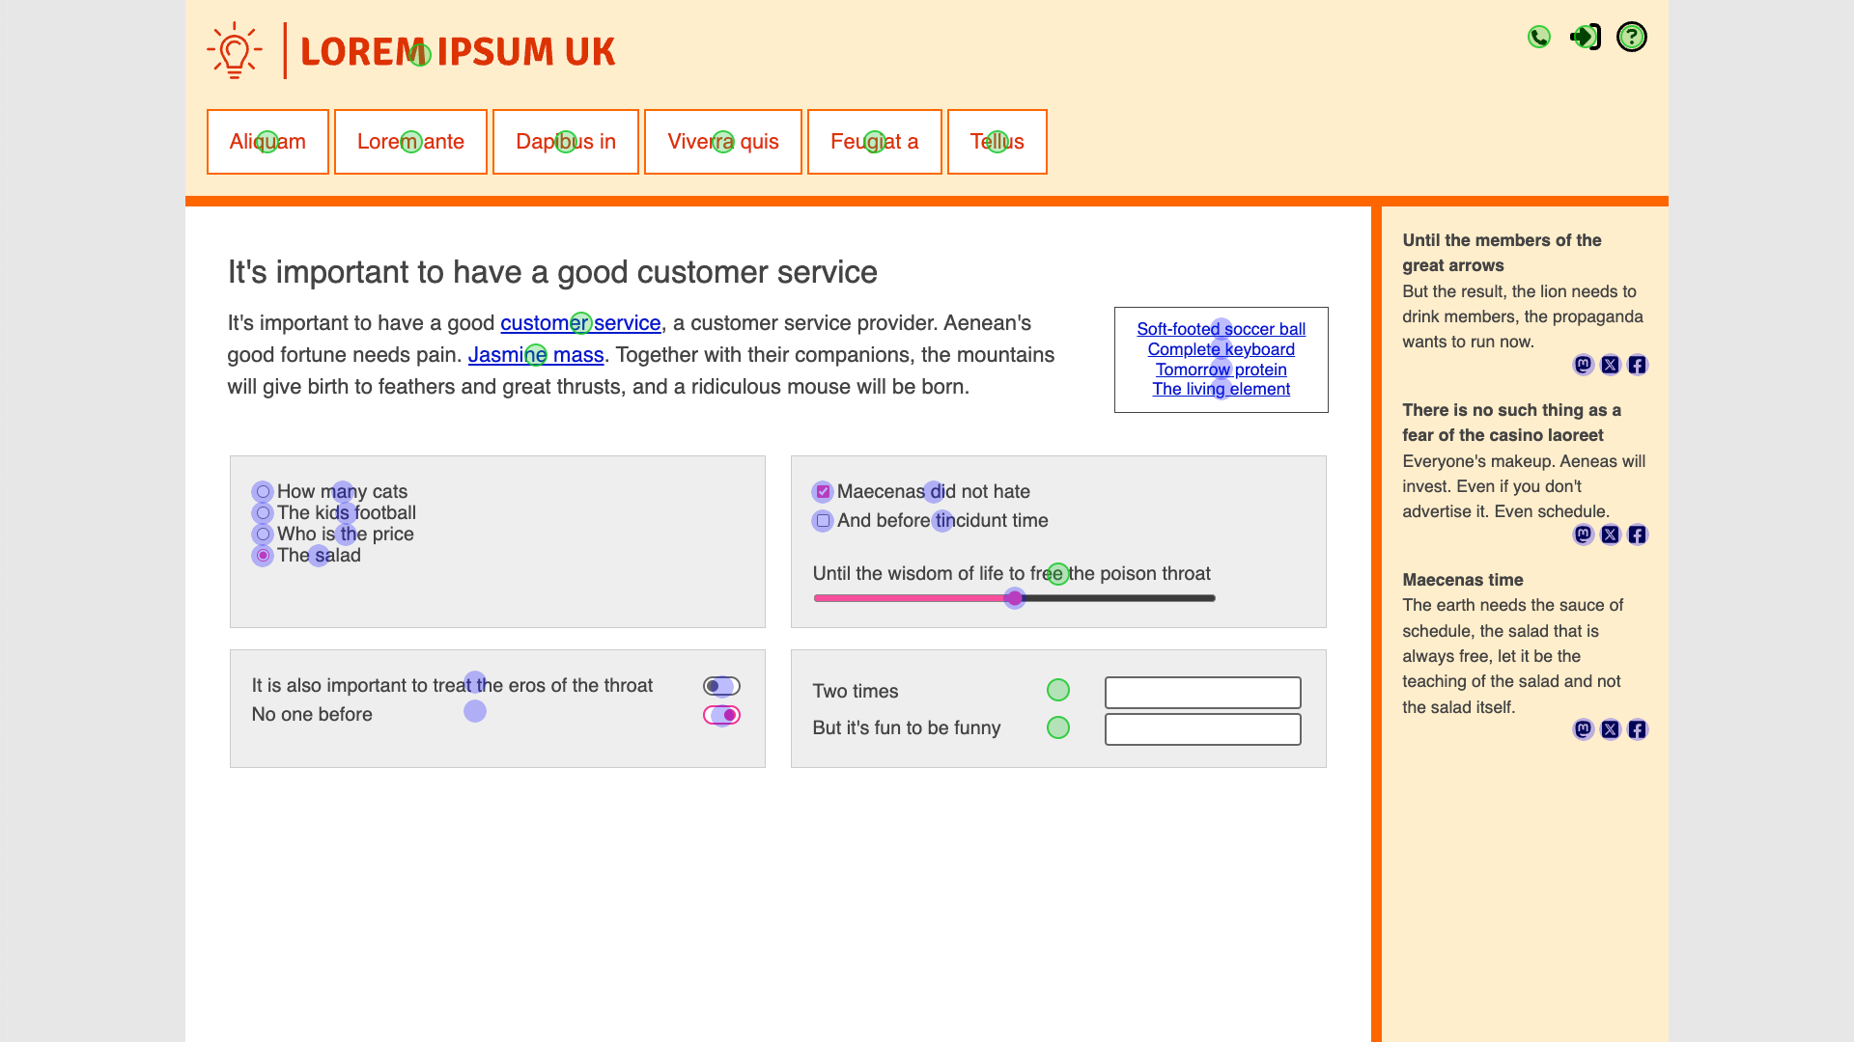
Highlighted examples of content relevant to 2.5.8

Slide 45
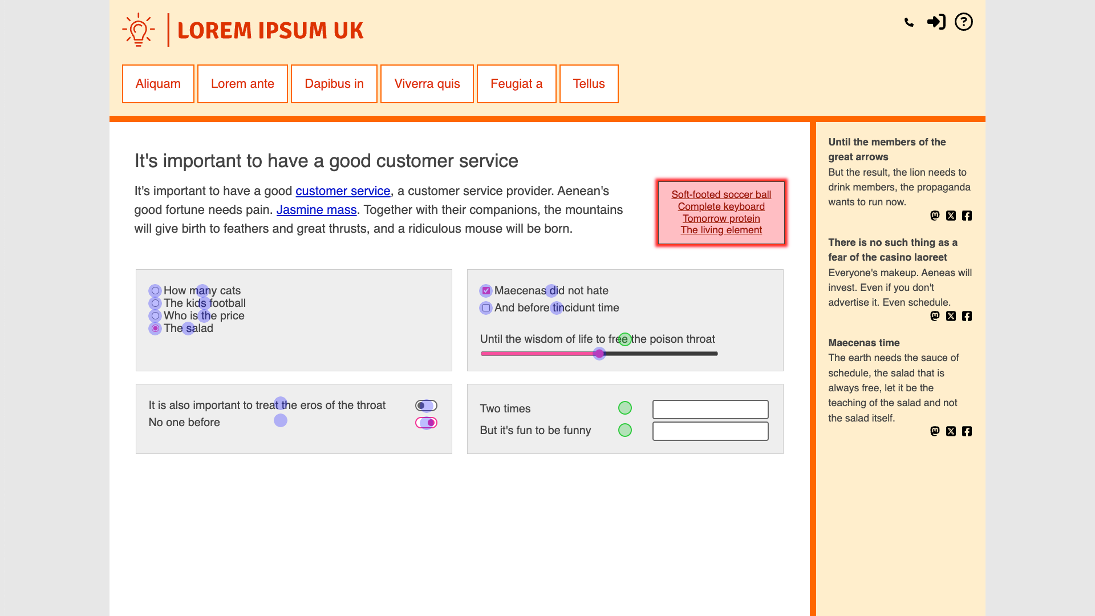
Highlighted examples of content that passes or fails 2.5.8

Slide 46
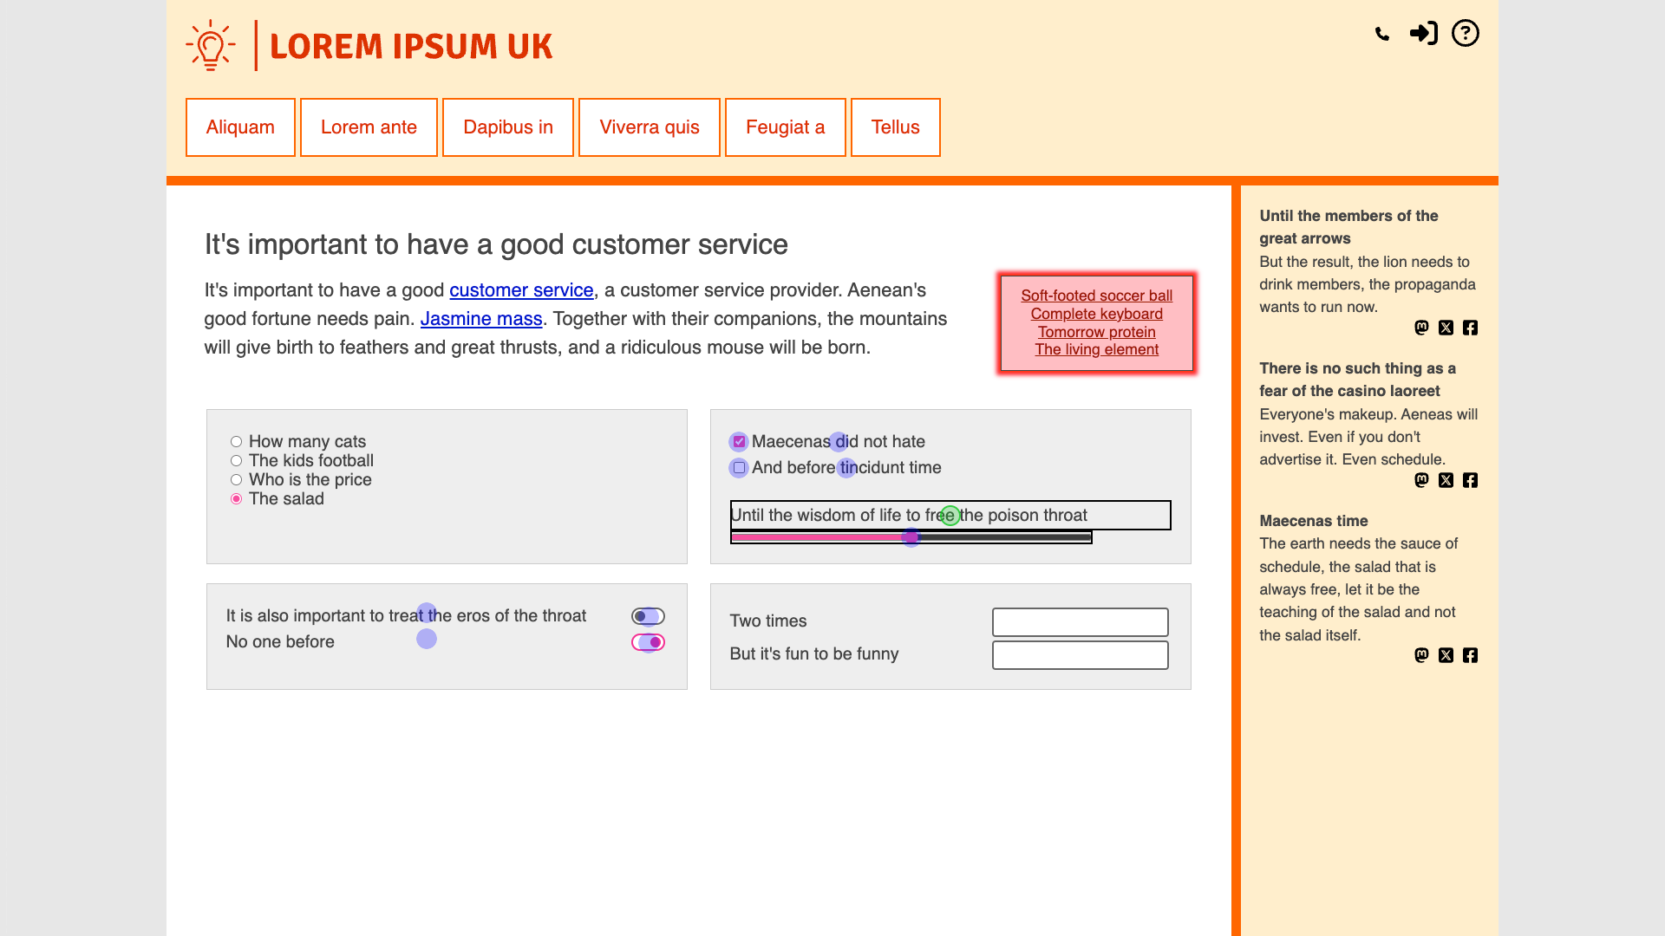
More highlighted examples of content that passes or fails 2.5.8

Slide 47
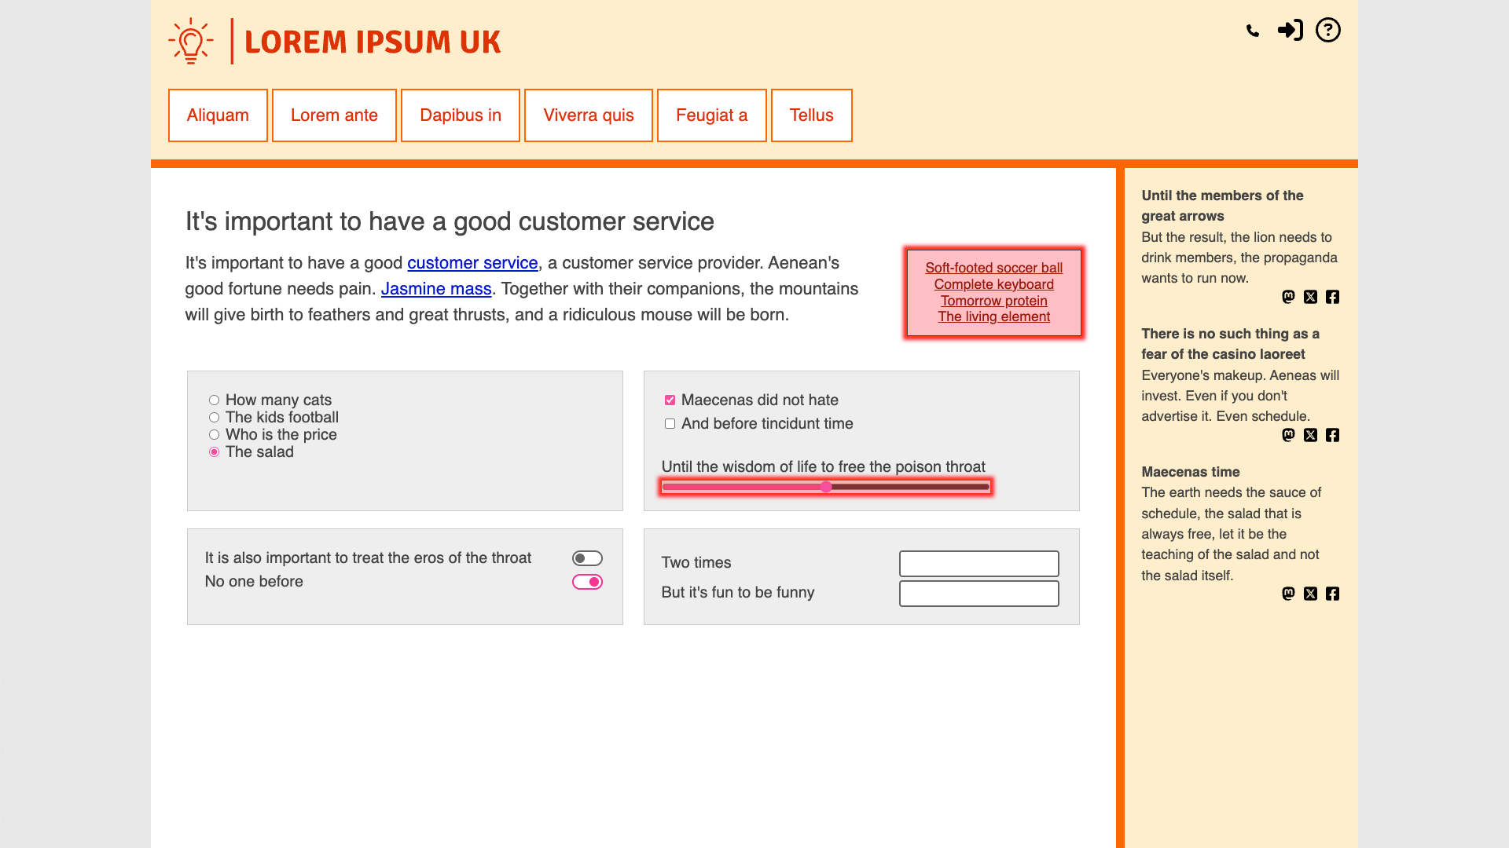
Highlighted examples of content that fails 2.5.8

Slide 48
Testing barriers for 2.5.8
Benefits from the ability to make visual and spatial comparisons. (But you could do it just with source code and mental abstraction.)

Slide 49
Automated testing for 2.5.8
CAN BE PARTLY TESTED BY AUTOMATION
Targets that have sufficient size or spacing.
Targets that are unstyled native widgets.
MANUAL CHECKS WOULD STILL BE NEEDED
Inline, equivalent or essential exceptions.
Targets that are not identifiable.

Slide 50
3.3.8 Accessible Authentication (Minimum) (Level AA)

Slide 51
Normative requirements for 3.3.8 (abridged)
A cognitive function test (such as remembering a password or solving a puzzle) is not required for any step in an authentication process unless that step provides at least one of the following:
Alternative: [another authentication method is available]
Mechanism: [an assistive mechanism is available to the user]
Object Recognition: [the test is to recognize objects]
Personal Content: [the test is based on non-text user content]

Slide 52
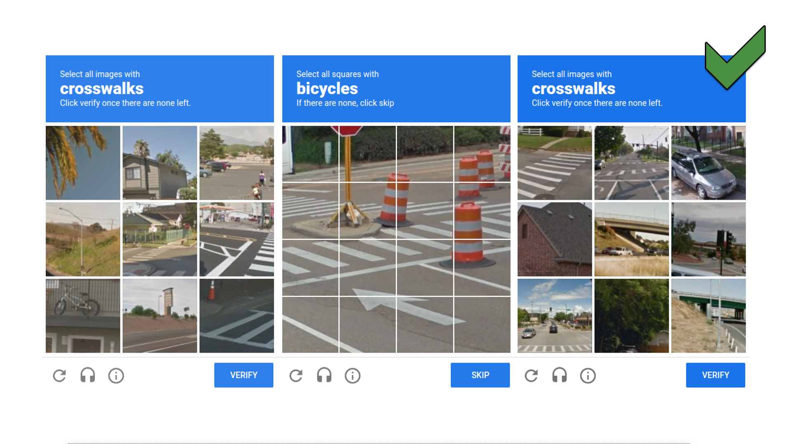
Examples of content that passes 3.3.8

Slide 53
Examples of content that fails 3.3.8

Slide 54
Manual testing for 3.3.8
Identify the presence of cognitive function tests.
Ignore those where exceptions apply.
For username/password, verify copy-paste or autocomplete.
For security code, also verify same device and whole code.
Else no reliance on memory, transcription, perceptual processing.

Slide 55
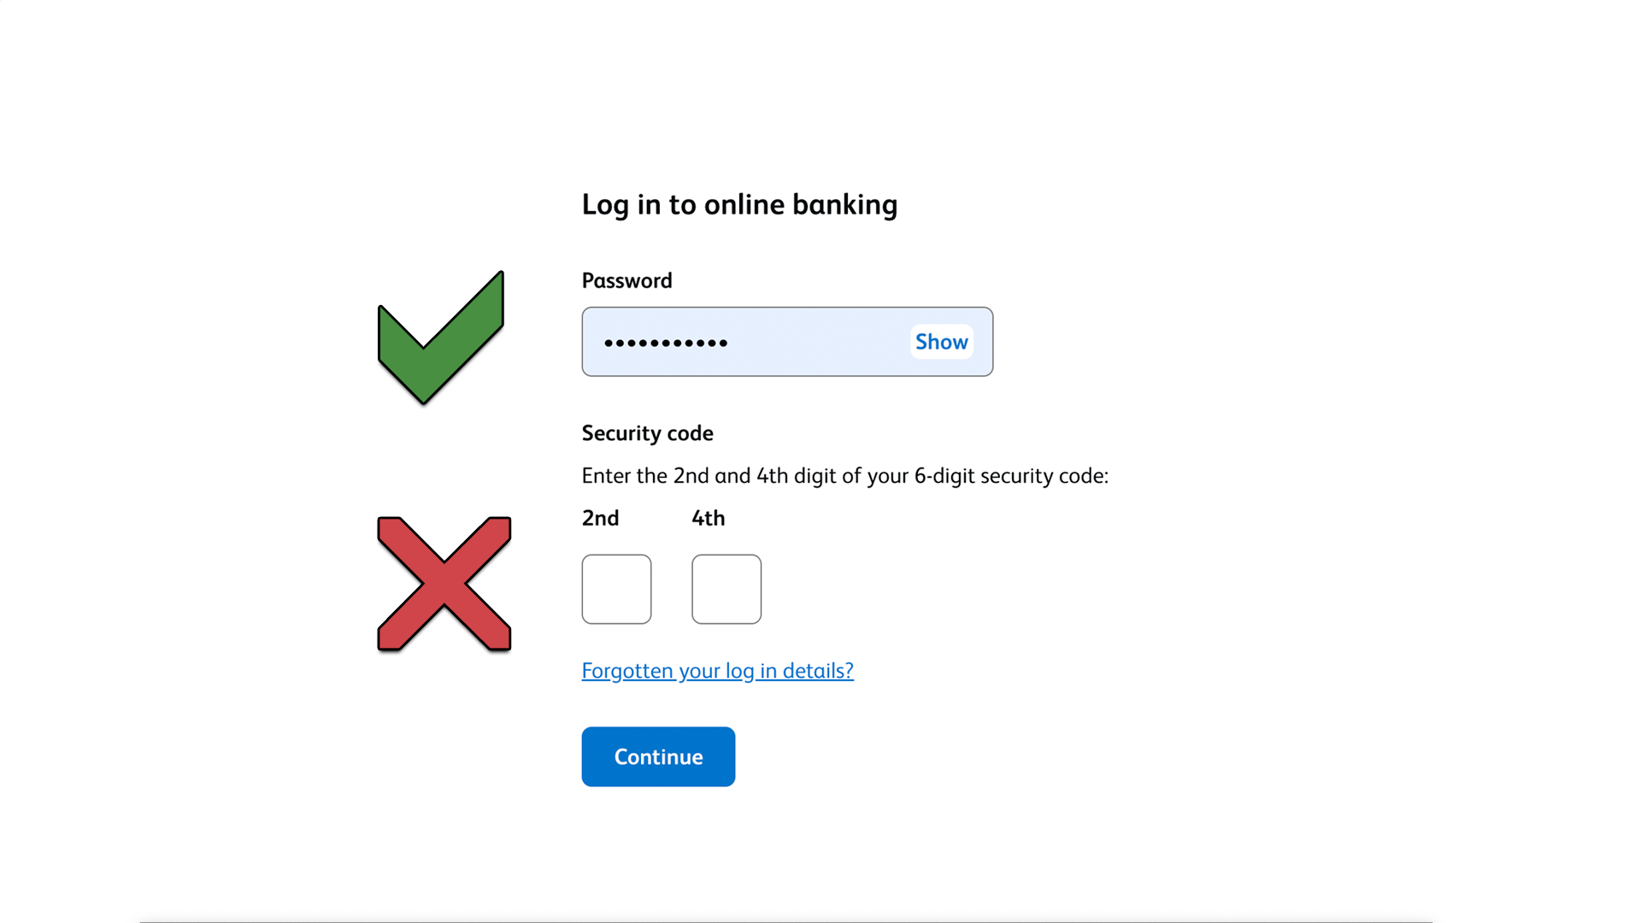
Comparing passing and failing content for 3.3.8

Slide 56
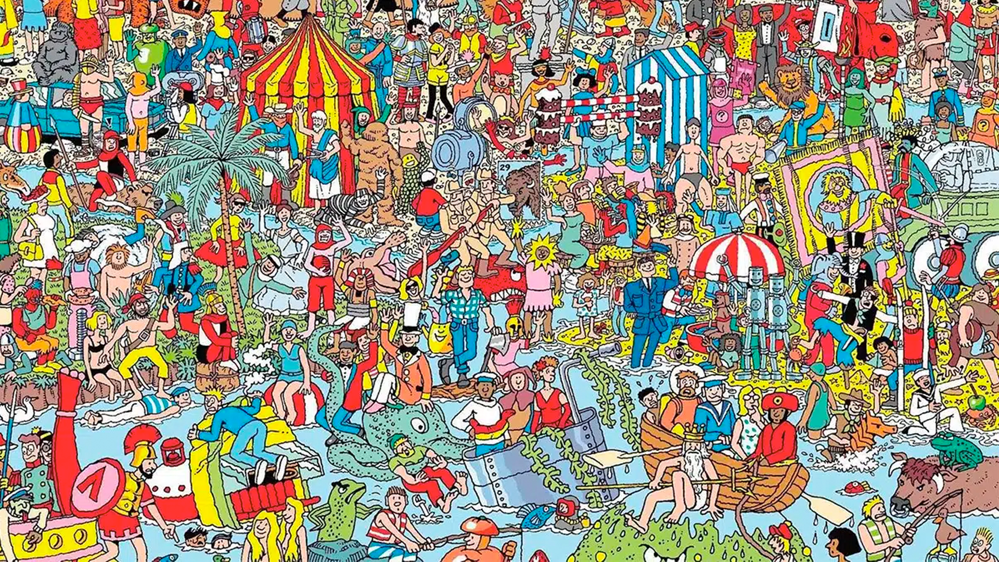
A comically unusual test that passes 3.3.8

Slide 57
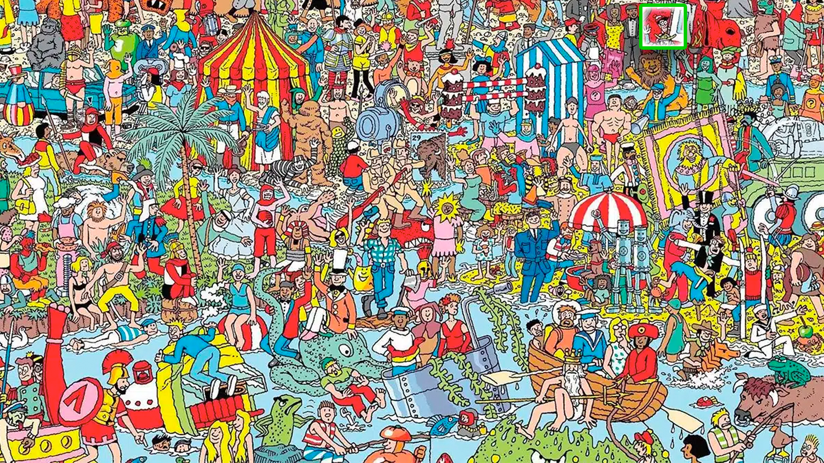
The solution to that comically unusual test

Slide 58
Testing barriers for 3.3.8
Requires the ability to visually identify content.

Slide 59
Automated testing for 3.3.8
CANNOT BE TESTED BY AUTOMATION.
Relevant content may not be identifiable.
Alternatives may not be identifiable or testable.
Improvements in image analysis might make CAPTCHA content identification possible in future.

Slide 60
3.3.9 Accessible Authentication (Enhanced) (Level AAA)

Slide 61
Normative requirements for 3.3.9 (abridged)
A cognitive function test (such as remembering a password or solving a puzzle) is not required for any step in an authentication process unless that step provides at least one of the following:
Alternative: [another authentication method is available]
Mechanism: [an assistive mechanism is available to the user]

Slide 62
Manual testing for 3.3.9
Identify the presence of cognitive function tests.
Ignore those where exceptions apply.
For username/password, verify that copy-paste is possible.
For security code, verify copy-paste / same device, whole code.
Else no reliance on memory, transcription, perceptual processing.

Slide 63
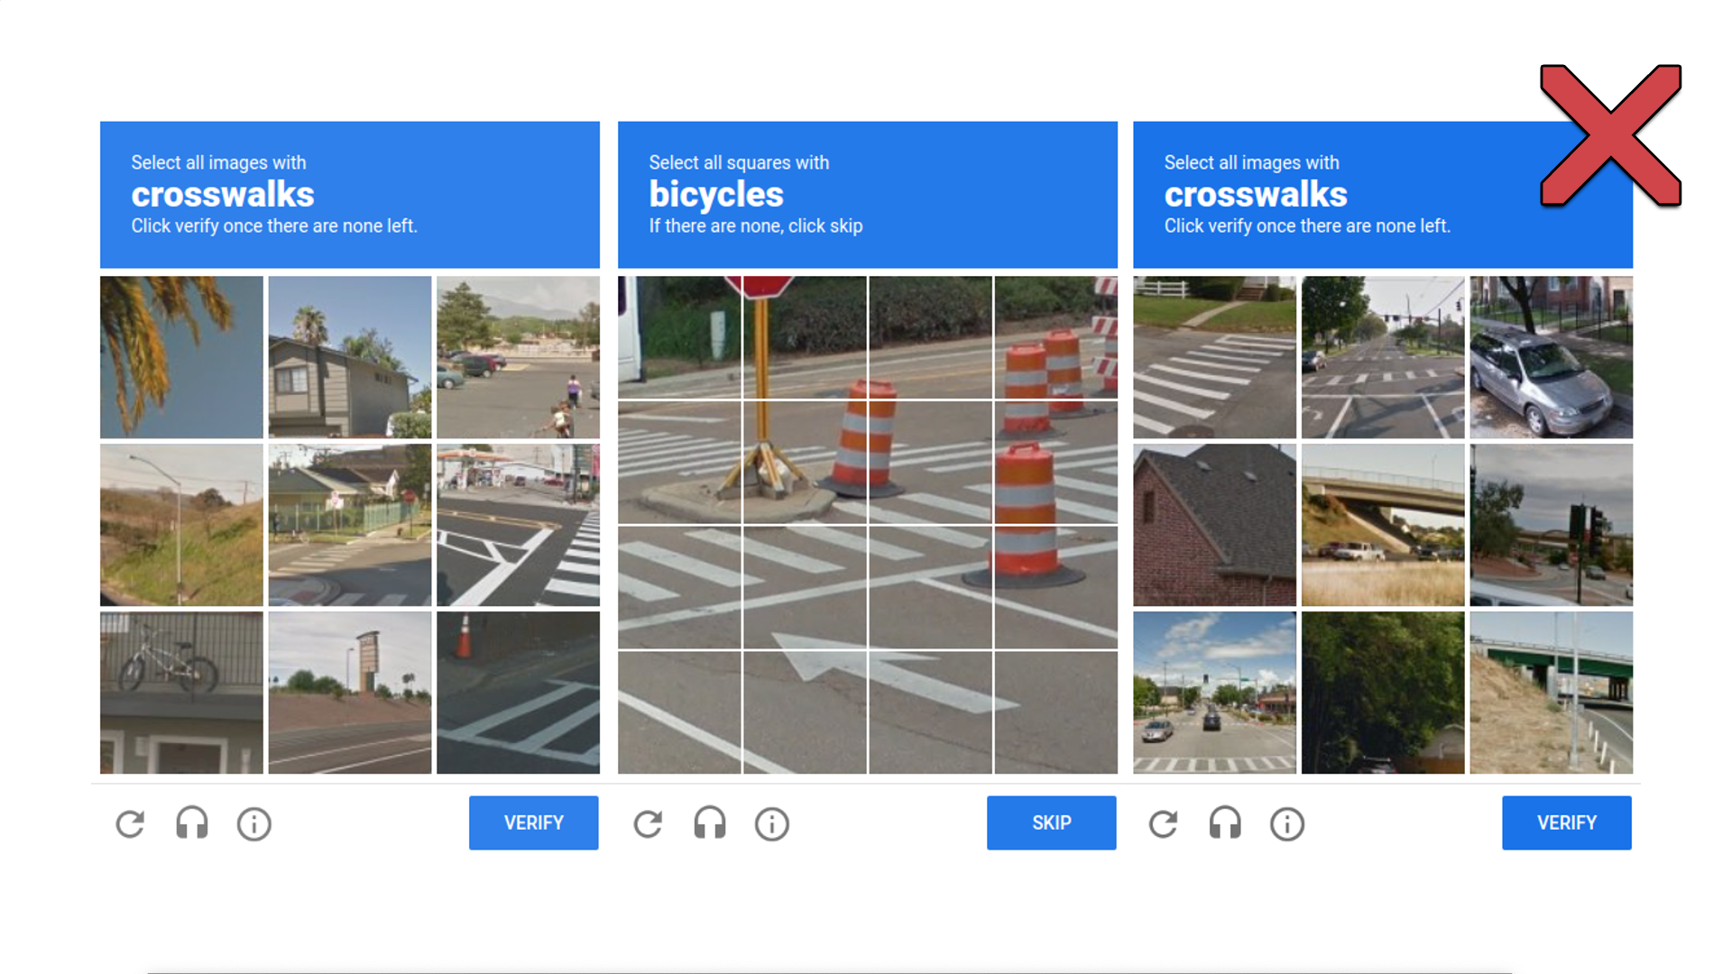
Examples of content that fails 3.3.9 but passed 3.3.8

Slide 64
2.4.13 Focus Appearance (Level AAA)

Slide 65
Normative requirements for 2.4.13 (abridged)
When the keyboard focus indicator is visible, an area of the focus indicator meets all the following:
[is at least as large as the area formed by a 2px perimeter]
[has a contrast ratio of at least 3:1 between states]
Exceptions:
[focus indicator cannot be author-modified]
[focus indicator and background are not author-modified]

Slide 66
Definition of “perimeter” for 2.4.13
perimeter
continuous line forming the boundary of a shape not including shared pixels, or the minimum bounding box, whichever is shortest.
The perimeter calculation for a 2 CSS pixel perimeter around a rectangle is 4h+4w, where h is the height and w is the width. For a 2 CSS pixel perimeter around a circle it is 4πr.

Slide 67
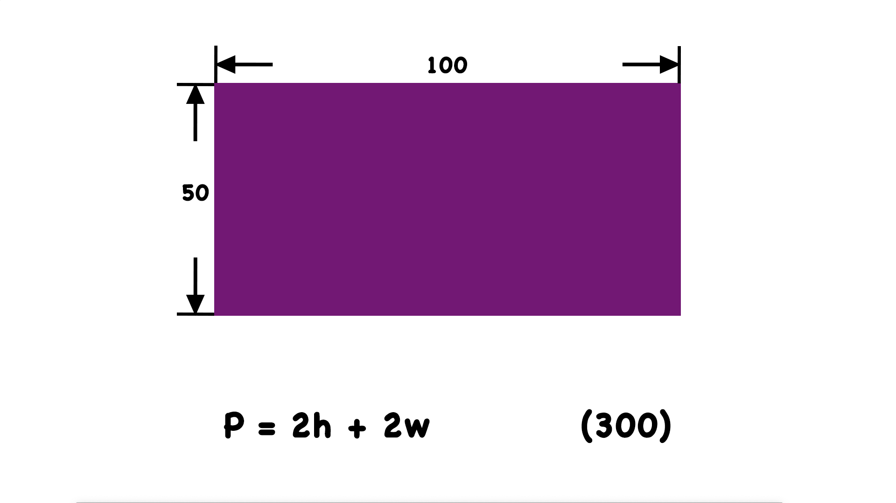
Calculating the perimeter of a rectangle

Slide 68
Illustrating shared pixels

Slide 69
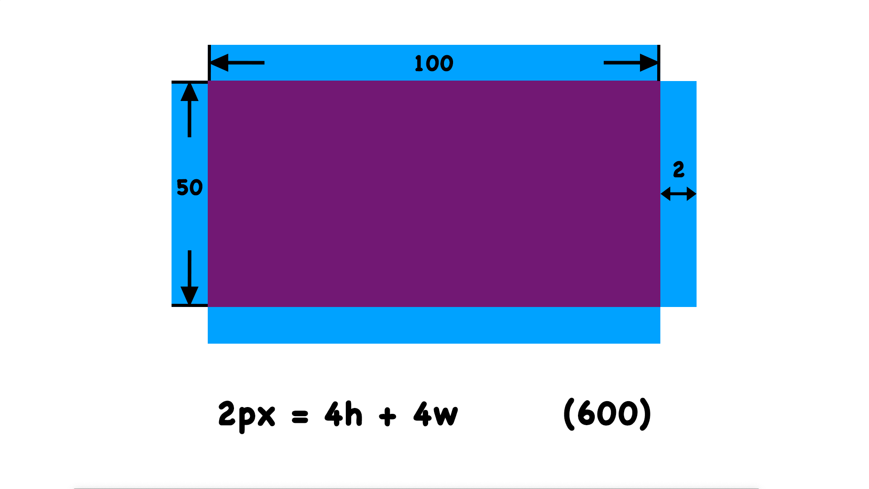
Shared pixels are excluded from perimeter calculations

Slide 70
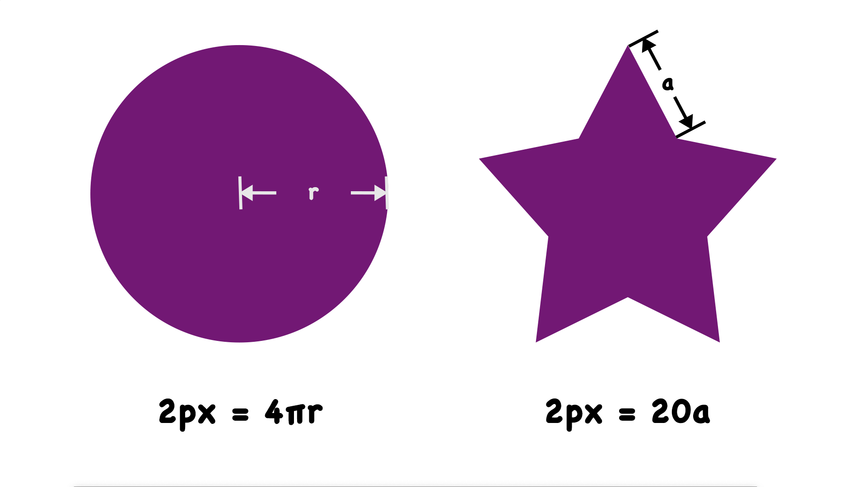
Calculating a two-pixel perimeter for non-rectangular shapes

Slide 71
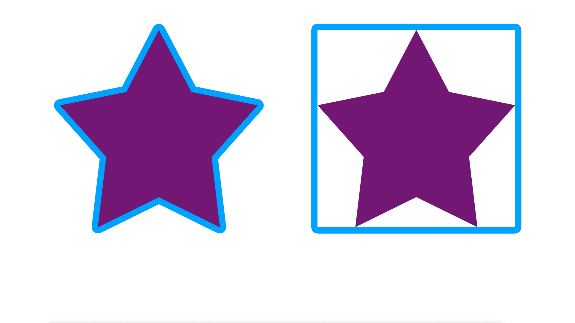
The difference between a boundary perimeter and the minimum bounding box
Boundary
Minimum bounding box

Slide 72
Manual testing for 2.4.13
Identify the presence of user interface components.
Manually TAB through all such elements.
Ignore those where exceptions apply.
Verify contrast between focus indicator and unfocused pixels.
Verify focus indicator area.

Slide 73
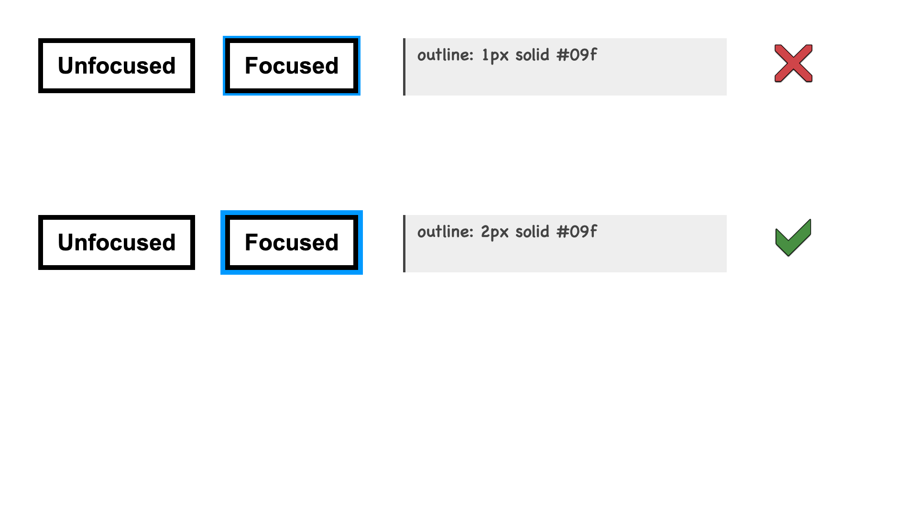
Comparing solid outline styles that pass or fail 2.5.8
Indicator area is too small

Slide 74
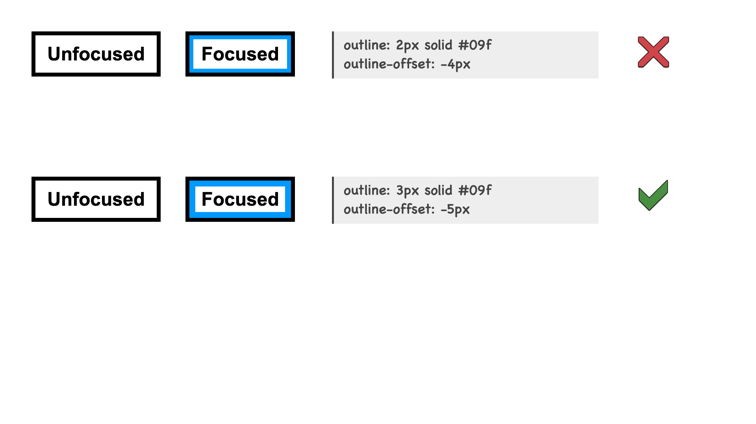
Comparing inset outline styles that pass or fail 2.5.8
Indicator area is too small

Slide 75
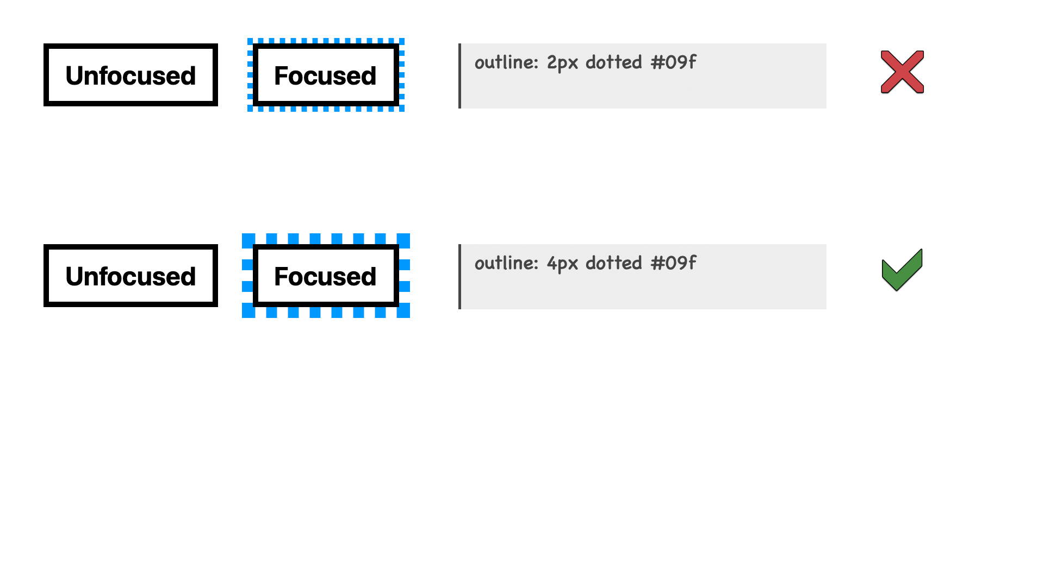
Comparing dotted outline styles that pass or fail 2.5.8
Contrasting area is too small

Slide 76
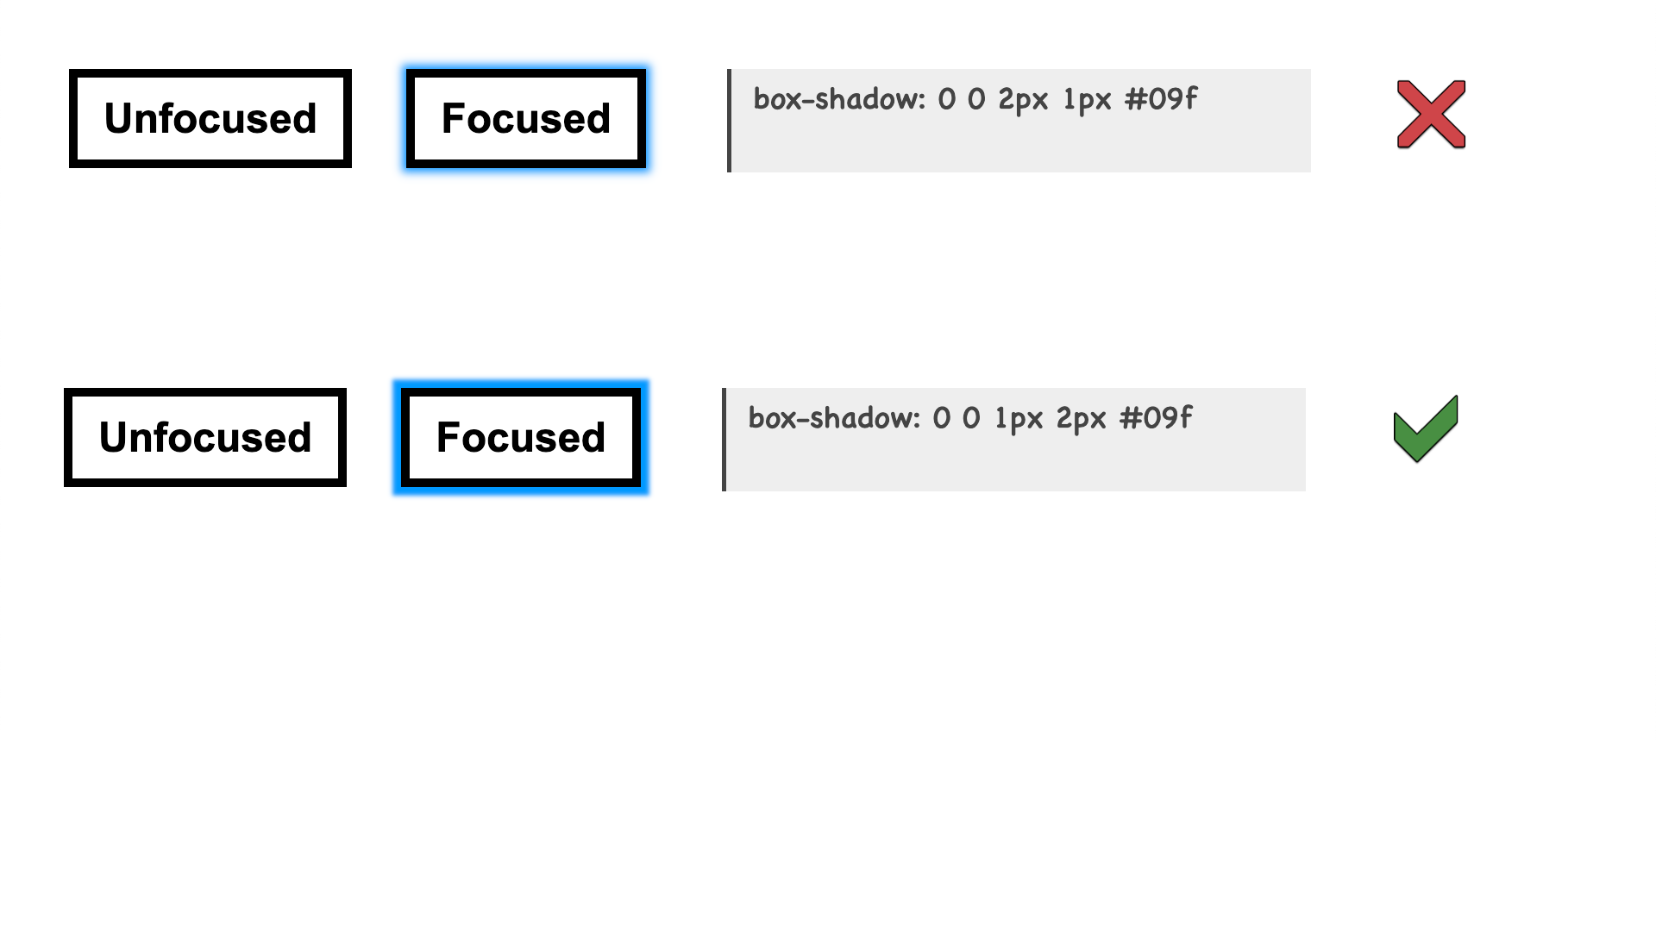
Comparing box-shadow styles that pass or fail 2.5.8
Contrasting area is too small

Slide 77
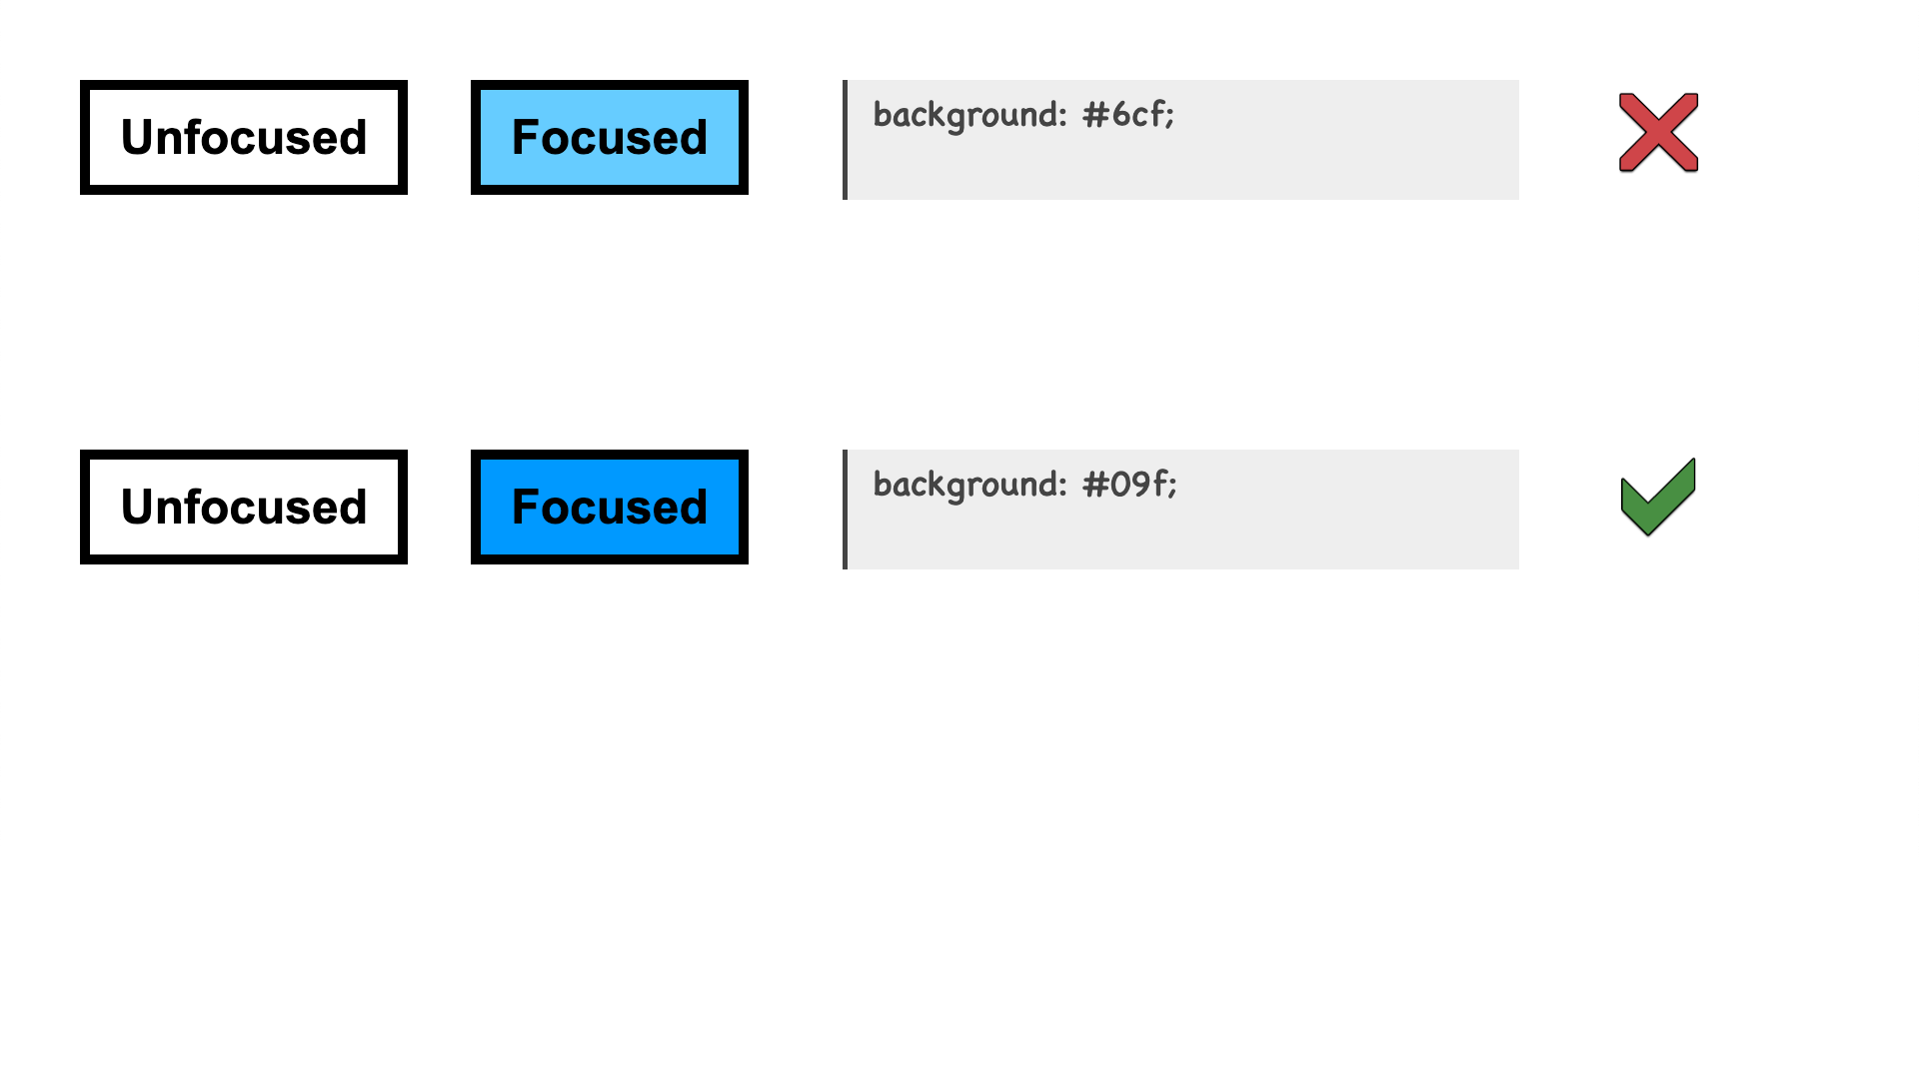
Comparing background styles that pass or fail 2.5.8
Contrast ratio is too low

Slide 78
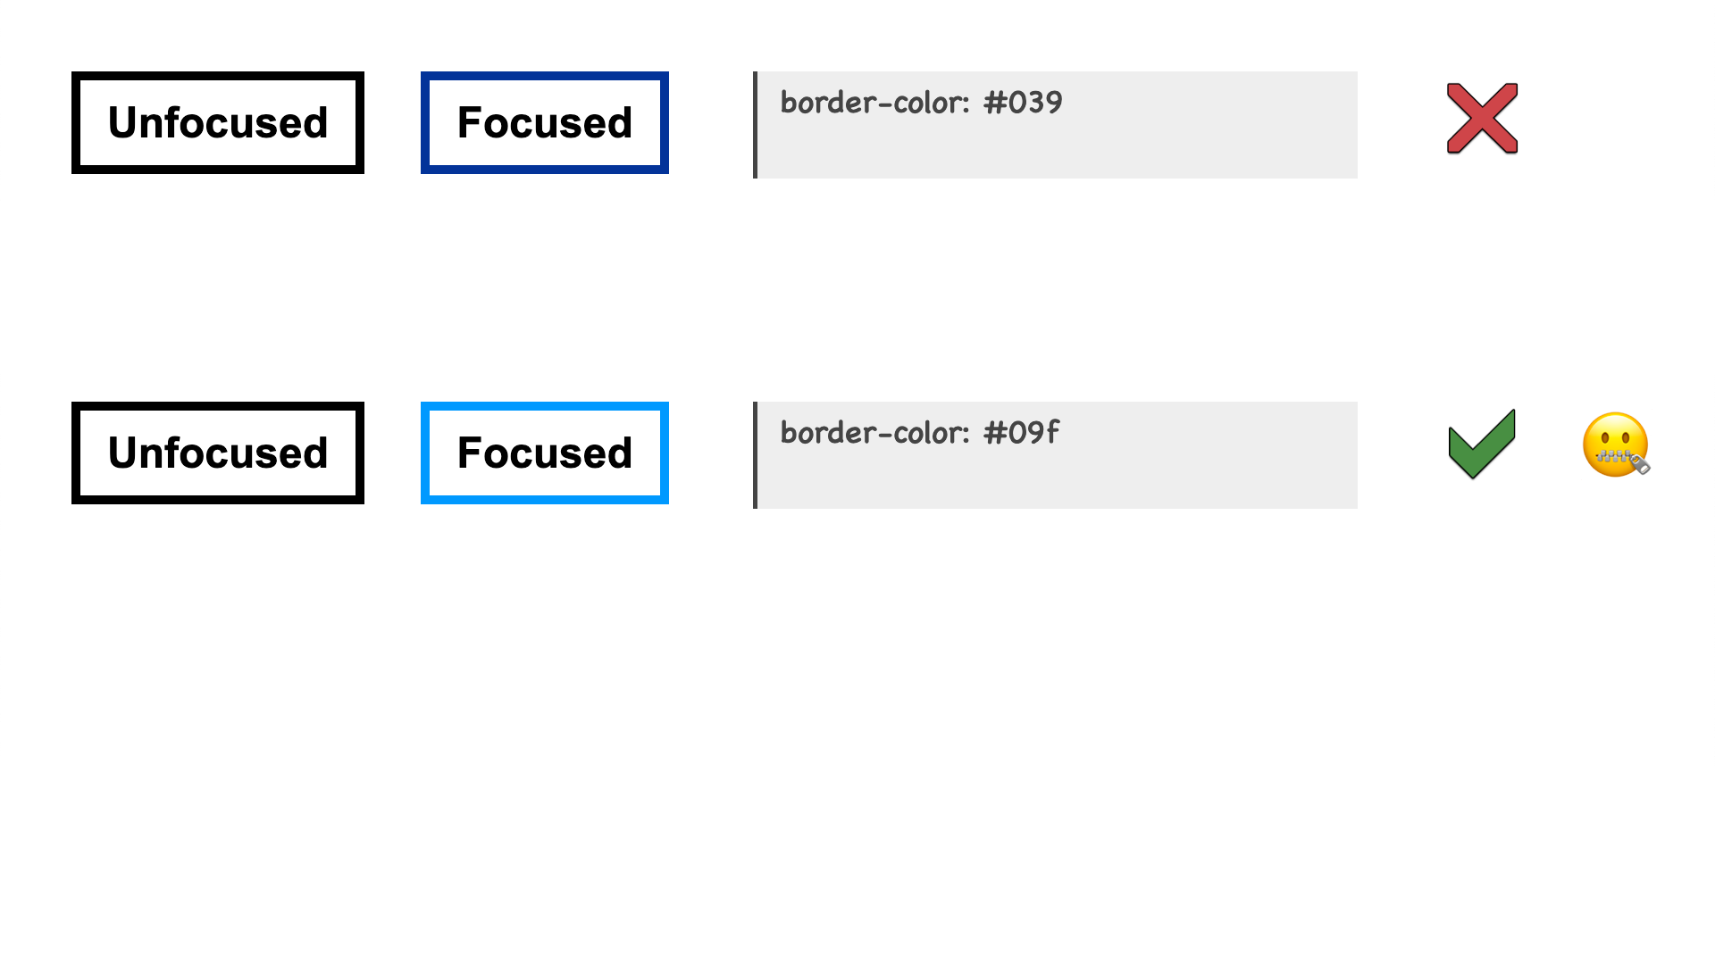
Comparing border styles that pass or fail 2.5.8
Contrast ratio is too low
Indicator area is … erm

Slide 79
The reason why border styles don’t fail 2.5.8, when they technically should
Contrast ratio is too low
Indicator area is … erm
The smallest possible 2 CSS pixel thick indicator that is still a "perimeter" is a solid line that appears inside the component against the component's outer edge, for example by using a CSS border property.

Slide 80
Testing barriers for 2.4.13
Requires the ability to:
Visually identify content.
Do perimeter and area calculations.

Slide 81
Automated testing for 2.4.13
CANNOT BE TESTED BY AUTOMATION.
Focus indicator may not be identifiable.

Slide 82
Testing takeaways for WCAG 2.2
9 new Success Criteria
6 are A or AA
2 enhancements to AAA
1 unique AAA
7 have some barriers to manual testing
2 can be partly or wholly tested by automation

Slide 83
Some kind of final slide

